Slide 1
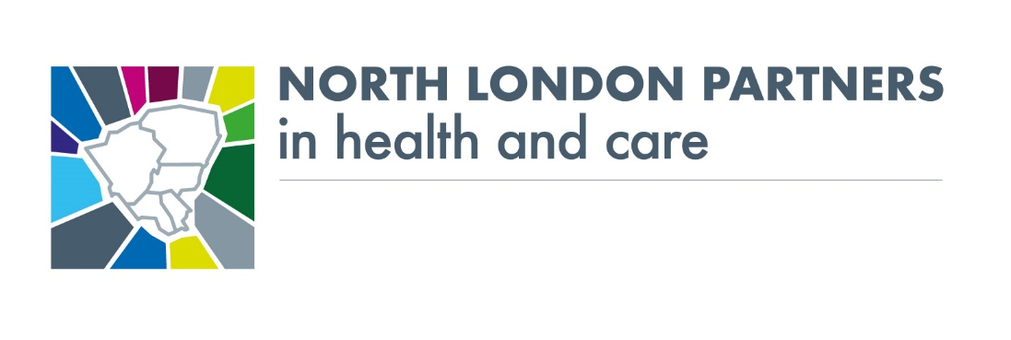
North Central London: Integrating Care to improve outcomes across our communities
Richard Dale, Executive Director of Transition NCL CCG
Collette Wood, Director of Integration, Barnet, NCL CCG
11 November 2021

Slide 2
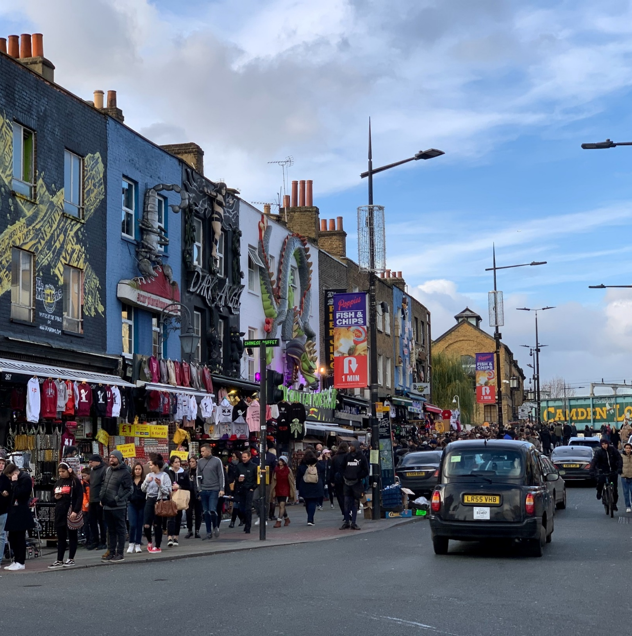
NCL Overview: who we are
Around 1.6 million residents, with a relatively young population in some boroughs compared to London average.
Diverse population with historic high migration – from within UK and abroad; around 25% of people do not have English as their main language.
Higher rates of deprivation than some London areas, with pockets of deprivation across all boroughs.
Significant variation in life expectancy between most affluent and most deprived areas.
Approx. 200,000 people in NCL are living with a disability.
¹ Index of Multiple Deprivation, 2019

Slide 3
NCL overview: Our partnership
GP Practices
Enfield Local Authority
338,143 registered population
324,000 resident population
Barnet 56
Enfield 48
Islington 33
Chase Farm Hospital
Camden 35
Haringey 37
(Total 209)
4
5
5
St. Michaels Primary Care
Barnet Hospital
NHS Trusts
Barnet Local Authority
422,630 registered population
375,000 resident population
4
5
1
Whittington Health NHS Trust
11
Royal National Orthopaedic Hospital
2
University College London Hospitals NHS Foundation Trust
Haringey Local Authority
316,910 registered population
267,000 resident population
3
NMUH
3
North Middlesex University Hospital NHS Trust
Edgware Community Hospital
Finchley Memorial Hospital
5
9
9
4
The Royal Free London NHS Foundation Trust
5
Barnet, Enfield and Haringey Mental Health NHS Trust
5
St Anns Hospital
6
Camden and Islington NHS Foundation Trust
Islington Local Authority
251,606 registered population
221,000 resident population
Highgate Mental Health Centre
6
1
The Whittington
7
Tavistock and Portman NHS Foundation Trust
Royal Free
8
Central and North West London NHS Foundation Trust (Camden Community)
4
7
Tavistock and Portman
9
Central London Community Healthcare NHS Trust (Barnet Community)
Camden Local Authority
283,789 registered population
235,000 resident population
6
St Pancras Hospital
10
8
CNWL
12
Moorfields Eye Hospital
Great Ormond St Hospital
2
UCLH
11
Royal National Orthopaedic Hospital
10
Great Ormond St Hospital
12
Moorfields Eye Hospital
Source: North Central London Devolution Pilot Outline Business Case November 2017

Slide 4
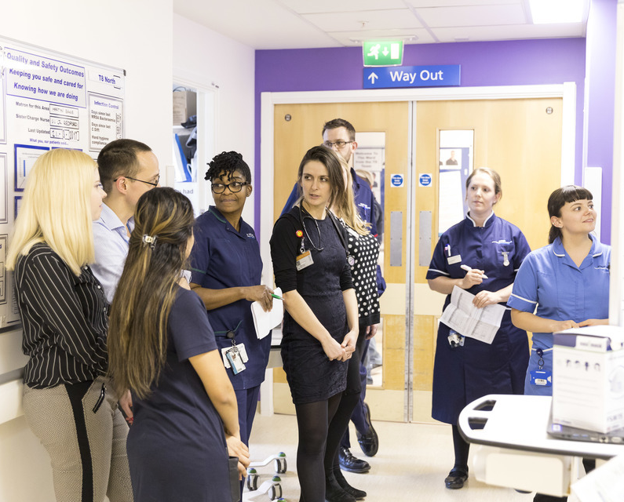
The purpose of an Integrated care System
The core purpose of an Integrated Care System is to:
improve outcomes in population health and healthcare
tackle inequalities in outcomes, experience and access
enhance productivity and value for money
help the NHS to support broader social and economic development.
Each ICS will have a responsibility to coordinate services and plan health and care in a way that improves population health and reduces inequalities between different groups.
This way of working closely reflects how the NHS and Councils in North Central London have already been working together in recent years, to improve our population’s health and reduce inequalities through greater collaboration.

Slide 5
NCL Overview: our developing system
Together with system partners are designing what our Integrated Care System (ICS) will look like at neighbourhood, place and system-level.
Neighbourhood network
Neighbourhood network
Neighbourhood network
Neighbourhood network
Neighbourhoods build on the core of the primary care networks through multidisciplinary teams taking a proactive population based approach to care at a community level.
5 x Place-Based Partnerships
The work at borough partnerships is focussed on bringing together partners develop and coordinate services based on agreed outcomes for their populations.
Public engagement and resident voice
NCL ICS
The NCL ICS will focus on activities that are better undertaken at an NCL level where a larger planning footprint increase the impact or effectiveness of these functions.

Slide 6
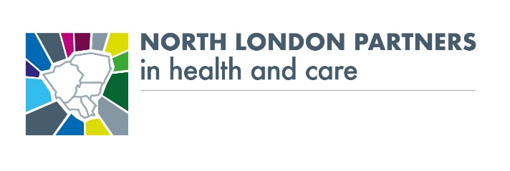
Community involvement and representation
Health and Wellbeing Boards are linked to all borough partnerships:
Most boroughs have updated their Health and Wellbeing Board ToR to include a link to the Borough Partnerships.
HASCs also regularly request reports on the development of integrated care locally.
Health and Wellbeing Boards
Patient and resident engagement is being undertaken in different forms across borough partnerships:
All partnerships have their local Healthwatch as members on their partnership groups.
Some Healthwatch members leads on specific areas of focus/priorities within the partnership.
ICPs have engagement groups (e.g. Haringey Citizen Health & Care Advisory Board, Camden Citizens Assembly, Islington conducts regular community engagement events).
CCG borough teams also support a patient engagement forum, with resident and VCS representation.
CCG Community Members sit on many of our committees and support wider engagement work.
Patient & resident involvement & engagement
Engaging the VCS
Voluntary & community sector organisations play a role in all partnerships:
VCS is represented on all partnership groups across all boroughs. In some, VCS leads on priorities areas (for example MIND in Camden alongside CIFT).
In all others they are “plugged into” the work and have played an increasingly significant role in delivery of partnership plans (social prescribing, mental health and wellbeing support, delivery of equipment, support to access services, support to comms campaigns such as flu).

