Slide 1
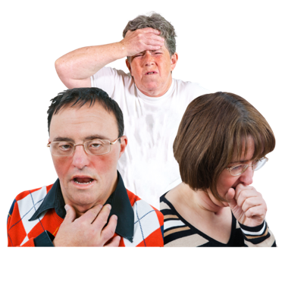
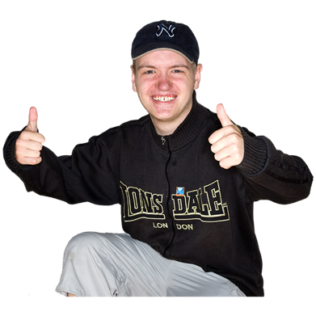
Long COVID recovery
My health matters 02.12.2021
Dr Deirdre Reilly, Clinical Psychologist, BLDS

Slide 2
What is Long COVID?
Symptoms that develop during or after getting COVID 19 which continue for more than 12 weeks
Symptoms are not explained by another diagnosis
Up to 1 in 10 people current effected
No data on how widely people with LD effected.
Most people have mild symptoms that will pass over time, others will struggle for longer periods and need further assessment

Slide 3
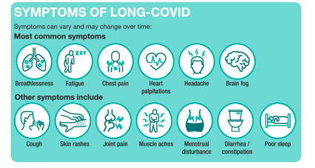

Slide 4
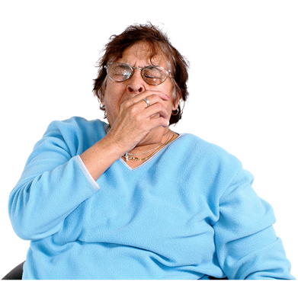
Post hospital
Be mindful of ongoing symptoms for anyone that was in hospital (though not just those hospitalised)
Three types of common symptoms:
1. Loss of strength & getting tired much more easily
2. Eating, drinking and speech difficulties
3. Feeling sad or worried more than before, scared or lonely. A ‘fuzzy head’ or hard to concentrate
Things to do…

Slide 5
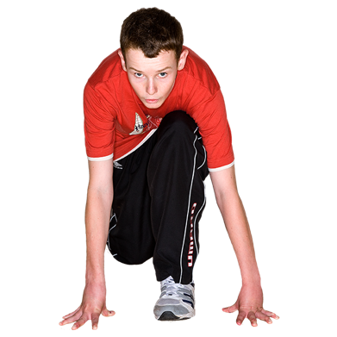
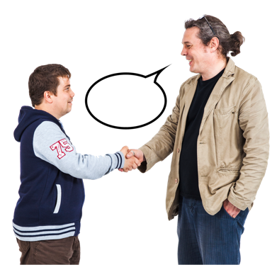
Exercise
Getting stronger and being more active will help your recovery
Exercise should make you a little out of breath but not so much that you can’t talk
Don’t exercise so much it makes you exhausted
If you don’t feel your strength coming back talk to your GP
What to look our for with people with LD – getting back to previous activities – struggling with everyday tasks? Start small, build up, check in frequently. Sleeping more than usual/ in the afternoon after activities, avoidance or refusal.

Slide 6
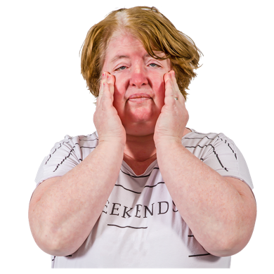
Coping with tiredness (fatigue)
If you feel tired all the time use the four Ps
Prioritise – what needs to be done each day, what can wait.
Pace – do not rush and use energy in one go e.g. 3 steps and rest rather than all the stairs at once and being exhausted – do not push.
Plan - plan to avoid extra trips and get people to help – e.g. can you do online shopping?
Position – too much bending or reaching can make you very tired – use equipment like a reacher, sit to do tasks (e.g. food prep)
People with LD – any equipment, any easy shortcuts – lift not stairs, OT referrals

Slide 7
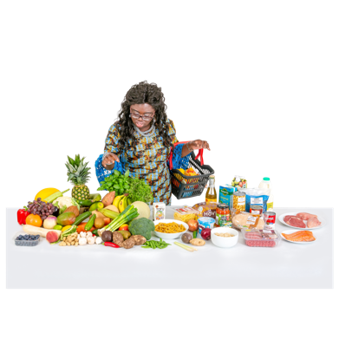
Loss of appetite
Might not feel hungry, might have lost taste or have sore throat/loss of voice
Try to eat lots of different types of food
Monitor weight and clothes – speak to GP
People with LD – loss of appetite, avoidance of meal times, keep a food diary, weigh regularly, try ranges of food, ask BLDS SLT for eating and drinking advice – report any choking or swallowing difficulties

Slide 8
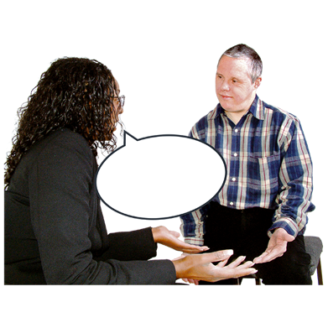
Help with speech and talking
Swallowing and talking difficulty after COVID - if on ventilator or respirator, coughing, or just loss of skills
If you are in pain when you swallow 6-8 weeks after having COVID speak to your doctor.
If your voice has not gone back to normal 6-8 weeks after speak to GP who can make a referral to specialist services
People with LD – any changes noticed by people who know them well, reporting or showing signs of pain, change to mood & behaviour, talk to GP and ask for referral to post covid services aswell as alerting BLDS SLT.

Slide 9
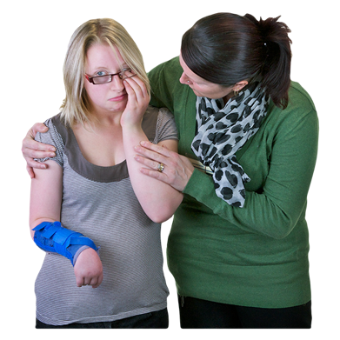
Feeling sad worried or lonely
Normal to feel this way after being poorly – support and listen. Hospital may have been scary and hard to understand.
Talking therapies help you deal with and understand feelings – local IAPT services to self refer
Talk to GP for advice.
People with LD – notice changes to mood & behaviour, think about trauma of hospital, loss of friends and family, understanding of what happened. Speak to BLDS psychology team.

Slide 10
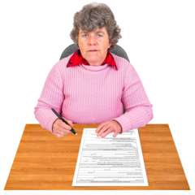
Help to go back to work
Going back to work can be hard
Can improve mood and help feel normal
Talk to boss about what help you might need and when is best to start back
For people with LD – think about slow return to work or daily routine, change to some tasks, sitting down, shorter shifts or day

Slide 11
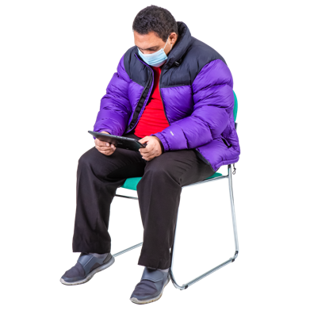
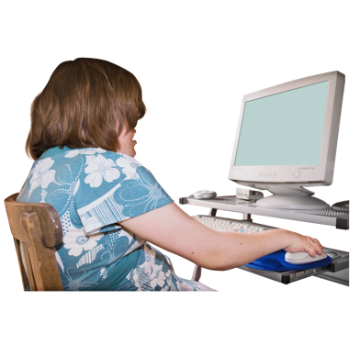
Where to get more help
Visit www.yourcovidrecovery.nhs.uk
If after visiting the website you see no improvement, your GP may refer you to the North Central London (NCL) Post COVID Service – MDT service with medical doctors, physiotherapy, SLT, OT and Psychology.
Support group - post intensive care
www.readingicusupport.co.uk
www.healthunlocked.com/icusteps
If not in ICU
www.selfhelp.org.uk/COVID-19_Survivors_Group_UK

Slide 12
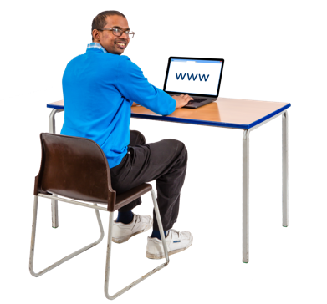
Resources
Breathlessness
https://www.kcl.ac.uk/cicelysaunders/resources/khp-gp-breathlessness-resource.pdf
Activity and rehabilitation
https://www.rcot.co.uk/coronavirus-covid-19-0
Read these resources and put yourself in the shoes of people with an LD, report symptoms to GP in these terms.

Slide 13
Contact
If you want to discuss a client with LD and possible Long Covid contact d.reilly@nhs.net
Aim to support access of people with LD to the Long COVID service

