Slide 1
Sexual Health Services for people with Learning Disabilities
Justine Maher
Specialist Nurse in Sexual Health for Learning Disability

Slide 2
Barriers to good sexual relationships
Lack of knowledge around sex, reproduction, STIs, risk.
Unable to access appropriate information
Not considered as having sexual needs / rights.
Lack of privacy
Restricted by family or carer concerns/beliefs
Clinic services ill-prepared to deal with LD patients
Lack of support or acknowledgment of LGBTQ+ needs.
Social isolation
Anxiety / stress accessing health services
Housing services preventing social and sexual contact
Notes:
3% of PWLD live with a partner compared to 70% general population

Slide 3
What is the Bridge Service?
To improve access and bridge any gaps to sexual health services for anyone 16+ with a learning disability and/or autism
Learning Disabilities Coordinator Role created 2018 in Camden & Islington
New role recently commissioned for Borough of Barnet- Specialist Nurse in Sexual Health for LD
A single point of contact for service users, support staff, family and carers.
Based at Edgware Hospital and Vale Drive Primary Care Centre
Offer 1:1 and group sexual health support sessions in clinic
Develop and run health promotion outreach and STI screening events in community settings.

Slide 4
Clinic services
Clinic at Edgware Hospital, Vale Drive Primary Care Centre, option also at Archway Centre
Testing and treatment for all Sexually transmitted infections including HIV
Full contraception supply and fit + specialist clinics
Consultant referral, HSV/HPV, Dermatology
PEP and PrEP clinics
Clinical psychology and sexual problem clinic (SPATS)
Safeguarding teams
Microscopy onsite
Direct booking, extended appointments, easy read information

Slide 5
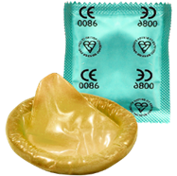
A free sexual health and support service for people with learning disabilities (>16yrs)
Choice of clinics: Edgware, Vale Drive and Archway
Advice and support on sex and relationships
Condoms and contraception including LARC- Coils, Implants etc
Tests and treatment for infections (STIs)
A private and confidential service
Reasonable adjustments
Telephone or text 077 38 26 13 19 for more information and appointments

Slide 8
Edgware Clinic
Lower Ground Floor

Slide 9
Vale Drive

Slide 10
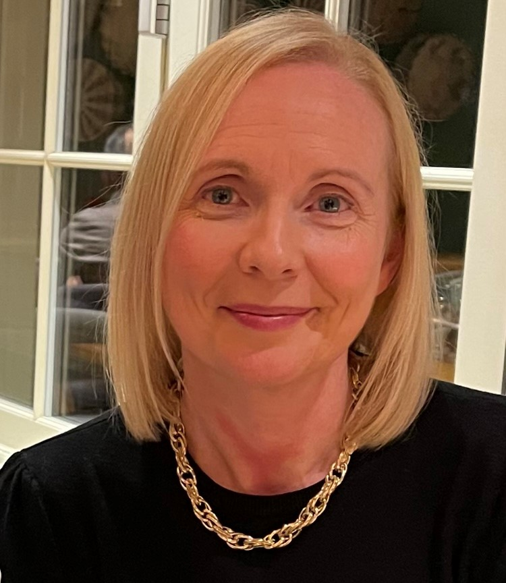
Any Questions?
Call or email Justine on 07738 261 319/ Justine.maher@nhs.net

