Slide 1
Bereavement In The Time of Covid Learning Disability and Loss
Michelle Brooks
Dramatherapist
Psychology Team
Barnet Learning Disability Service

Slide 2
Living in Extraordinary Times
The aims of this short presentation are to bring the ordinary back into the extraordinary by exploring loss and bereavement for pwld during the time of Corona
By re looking at the process of loss and bereavement we can be reminded of how important it is to address the lived experience of the pandemic and its impact on pwld as it impacts on all of us.
We can think together about how to break bad news and support the process of mourning and grief when these issues are even more alive

Slide 3
Ripple effect of pandemic losses
In our service we have had three deaths from Covid but our clients have had multiple losses of friends, family and staff and probably people in their local community and life.
If not deaths then absence due to sickness with the worry about their return
Unless we speak about the these losses it is hard to address the degree of difficulties that will accrue due to unprocessed grief

Slide 4
Grief Research
William Worden: Mourning is the process occurring after loss..grief is the personal experience of loss
Colin Murray Parkes: Bereavement is a turning point in personal development…a psycho-social transition that carries an increased risk to mental health and well being
Dennis Klass & Phyllis Silverman: Grief involves the continuing bonds that individuals maintain with the deceased and these continuing bonds can be a healthy part of the survivors ongoing life.

Slide 5
Grief Reactions
Worden (1991), who has done substantial work in the area of grief and loss, suggests grief consist of four dimensions: feelings, thoughts, behaviours and physical sensations.
Feelings:Sadness/anger/emptiness/lonliness/shock/numbness/confusion/lonliness/resentment/disbelief/resentment/denial/frustration/irritability
Thoughts: difficulties with concentration & making decisions, confusion and preoccupation with the person who died
Behaviours: withdrawl/physical or verbal aggression/changes in eating, toileting, sleeping/loss of interest in activities/sleep disturbed
Physical sensations: shortness of breath/pounding heart/hypertension/dizzy/shakes/sweating/pain reactions/fatigue/flareup of previous illness

Slide 6
The Impact of Learning Disability on Grieving
Although we know that grief reactions are very individual and unique and differ from one person to the other, there are some characteristics that can be seen in some people with disability.
These may relate to: COGNITION/COMMUNICATION/LIFE LEARNING EXPERIENCE
However it is important to realise that people with disabilities don’t need to have a full understanding of the concept of death to feel the loss. They may feel the loss and the grief by virtue of the fact that an important person is gone

Slide 7
A Continuum of Understanding - Cognitive
People with disabilities don’t need to have a full understanding of the concept of death to feel loss and grief by virtue of the fact that an important person is gone
There is a continuum of understanding of loss.
It begins as the final and irreversible nature of death begins to develop because the significant person in their life is no longer there.
What we know is the more a person with a learning disability understands the easier it is to process grief, to understand why they have the feelings they do, that we all share these feelings at these times, we are no different

Slide 8
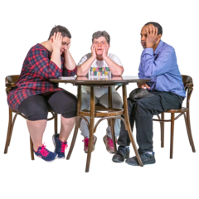
Communication of grief
People with a learning disability will have a range of communication styles or abilities or difficulties expressing negative emotions
For some people with disabilities, a change in behaviour might be a better indicator of grief and loss than what the person communicates directly through speech or through other means.
It is important to be sensitive to any changes in eating or sleeping patterns, or interest or participation in activities and social interactions. These may indicate how the person is coping with the loss.

Slide 9
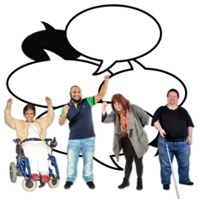
Life Learning Experiences
The life experiences of people with disabilities can make it difficult to deal effectively with loss and grief as parents and staff may treat them differently. For example, tjeymay try to shield them from the harsh realities of life with the fear that they may not be able to cope.
People with disabilities might have experienced multiple losses over time. They may have seen a number of friends or people they have known die. They may have also experienced ongoing staff turnover and changes in residential settings and living arrangements, many of which are beyond their control.
If the person has a limited number of close relationships and social supports, the impact of these losses may be more magnified than would otherwise be the case.
If the person who has died is the primary care giver, then the loss can be experienced at multiple levels.

Slide 10
One Persons Story - Video Clip

Slide 11
So what can we do?
Most important is to inform people and be open and honest
If a person is not told about a death openly and honestly, then:
The person’s ‘right to know’ has not been respected.
The person is denied the opportunity to learn about life and death.
The person is once again ‘shielded’ from bad news.
The person is denied the opportunity to be part of ‘normal’ grief activities, such as attending the funeral.
The person may perceive the loss, but not in an accurate way. They may comprehend the loss to be something different than what it actually is, and attach an interpretation of death that is much worse than the reality.

Slide 12
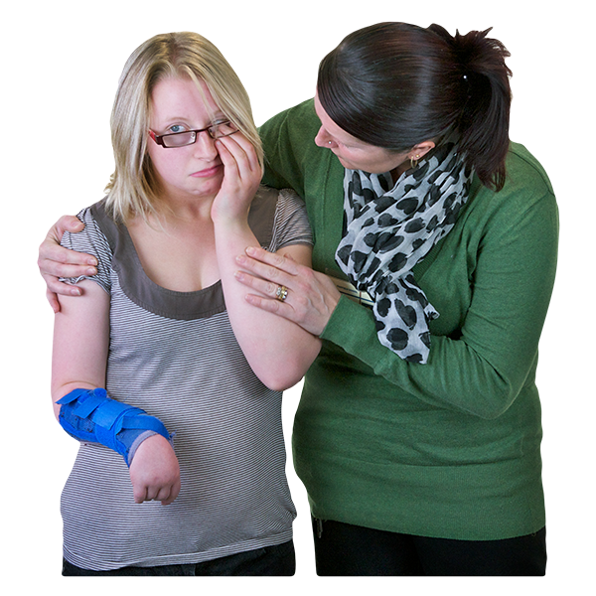
Our Role …..
Be there when needed
Encourage expression of emotion but tolerate silence
Listen don’t fix
Don’t judge but address fears and anxieties
Reassure and normalise the range of emotions felt
Validate feelings but assure they will shift with time
Allow time, offer reassurance and keep the dead present
This will support the increasing understanding of the reality of loss
These messages to be consistent across environments

Slide 13
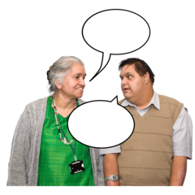
General Strategies for Support & The Reality of Grief
Generally encourage open and honest communication
Use clear and simple language, direct not metaphoric
Talk about the deceased and ask/allow questions
Support the reality of grief:
Using rituals created or existant
Encourage people to share with others who have also experienced losses
Keep reminders of the deceased visible

Slide 14
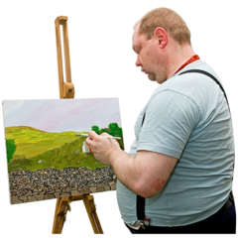
Creative Ideas to Assist in the Grief Process
Memory Boxes
Memory Gardens
Painting and collage to represent the person who died
Therapeutic Letters
Sympathy book for condolence cards
Tape of their favourite songs/poems/stories
Encourage a new leisure activity
Encourage forward planning …a new calendar for events to come

Slide 15
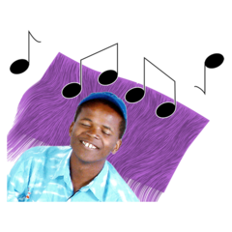
For Those Non Verbal
Support structures that are helpful for people with more complex needs who don’t have a formal communication system may need to draw less on strategies based on language and draw more heavily on environment based strategies.
Stategies may need to focus on providing a sense of security, stability, comfort, routine and continuity for the person. They may also include relaxation supports, such as sensory activities, based on the person’s preferences that are conducive to a calm state and/or expression of emotion.

Slide 16
Specialist Services
Grief can become complex where a person has:
A complicated grief history
Where the process is extended over a long period of time
In these cases a referral for specialist support may be needed

Slide 17
In Conclusion
Covid has become a feature of all of our lives and across the globe
Loss triggers anxiety about future possible losses and more especially when a person depends on their support networks for survival and so this basic anxiety will be ever present and need everyday attention and sensitivity.
Loss is an everyday part of the cycle of life and we need to include people with a learning disability in this to share our common humanity.

Slide 18
Refs and resources
Worden, J. W. (1991). Grief Counselling and grief therapy: A handbook for the mental health practitioner (2nd ed.). London: Springer.
Luchterhand, C., & Murphy, N. (1998). Helping adults with mental retardation grieve a death loss. Philadelphia: Taylor & Francis.
Other Resources
Luchterhand, C. (l998). Mental retardation and grief following a death loss: Information for families and other caregivers. Arlington, TX:
The Arc.
Hollins, S. (1995). Managing grief better: People with developmental disabilities. Habilitative Mental Healthcare Newsletter 14/3. Available at: http://www.thearc.org/faqs/grief.html.
Watchman, K. (2000). Let’s talk about death : a booklet about death and funerals for adults who have a learning disability. Edinburgh, UK: Scottish Down’s Syndrome Association.
Irene Tuffrey …..Breaking Bad News

