Slide 1
BLDS Occupational Therapy
Lisa Sylvester and Amanda Martell

Slide 2
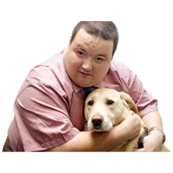
What is occupation?
Occupation is all the things we do in our day that we get enjoyment from or are meaningful/ important to us.
This can be:
Wearing our favourite clothes
Going for a walk
Working
Having pets
Cooking our meals
Meeting up with family and friends

Slide 3
What is an Occupational Therapist (OT)?
An Occupational Therapist is a trained person who supports people to be as independent as possible. An OT will complete a holistic assessment in the person’s environment, including community centres.
They can:
Provide advice and guidance
Help signpost people to the right places
Help modify ways of doing things to enable the person to complete the task
Adapt tasks using equipment
Complete environmental assessments
Occupational Therapists work in lots of different areas and work in different ways in each area.

Slide 4
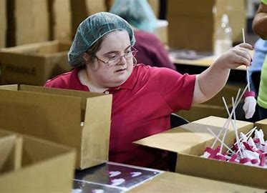
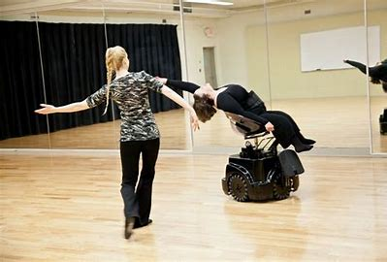
What’s our aim?
To promote health
To prevent disability
To develop/ maintain abilities
(COT, 2009)

Slide 5
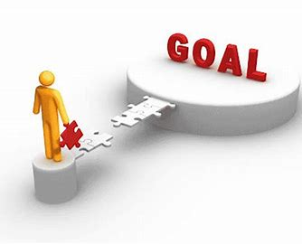
What does the Learning Disability OT do?
We can provide support to help with:
Maintaining current skills or learning new ones
Coaching families and carers to enable them to support the person
Help develop planning and organisation skills
Build on the person’s activities
Support the person to develop their work skills and signpost them to services
Making sure the environment works with the person
Work with other professionals to provide a holistic assessment

Slide 6
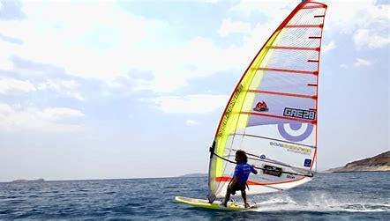
How this can help people
Increase their choices
Increase their control on their own lives
Build their activities
Maintain what they can do
Develop relationships and hopefully increase social skills
People feel valued and know they have a role and identity
Feel more secure or safe in their environment

